Slide 1
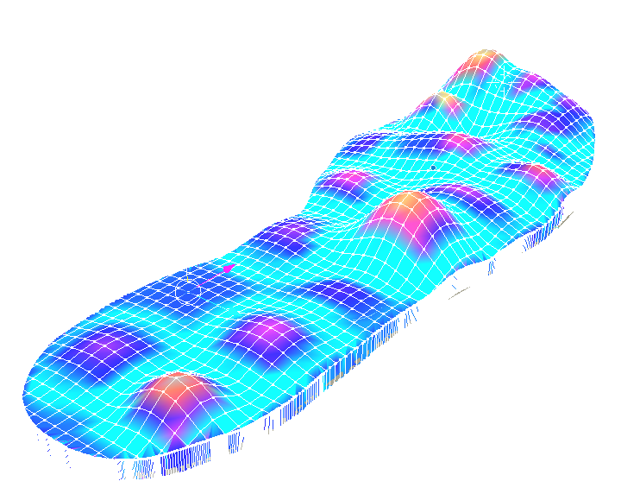
Lab 3 – Gait Analysis
Angel Ramirez, Priyanka Roy,
Davide, Hamza Dada

Slide 2
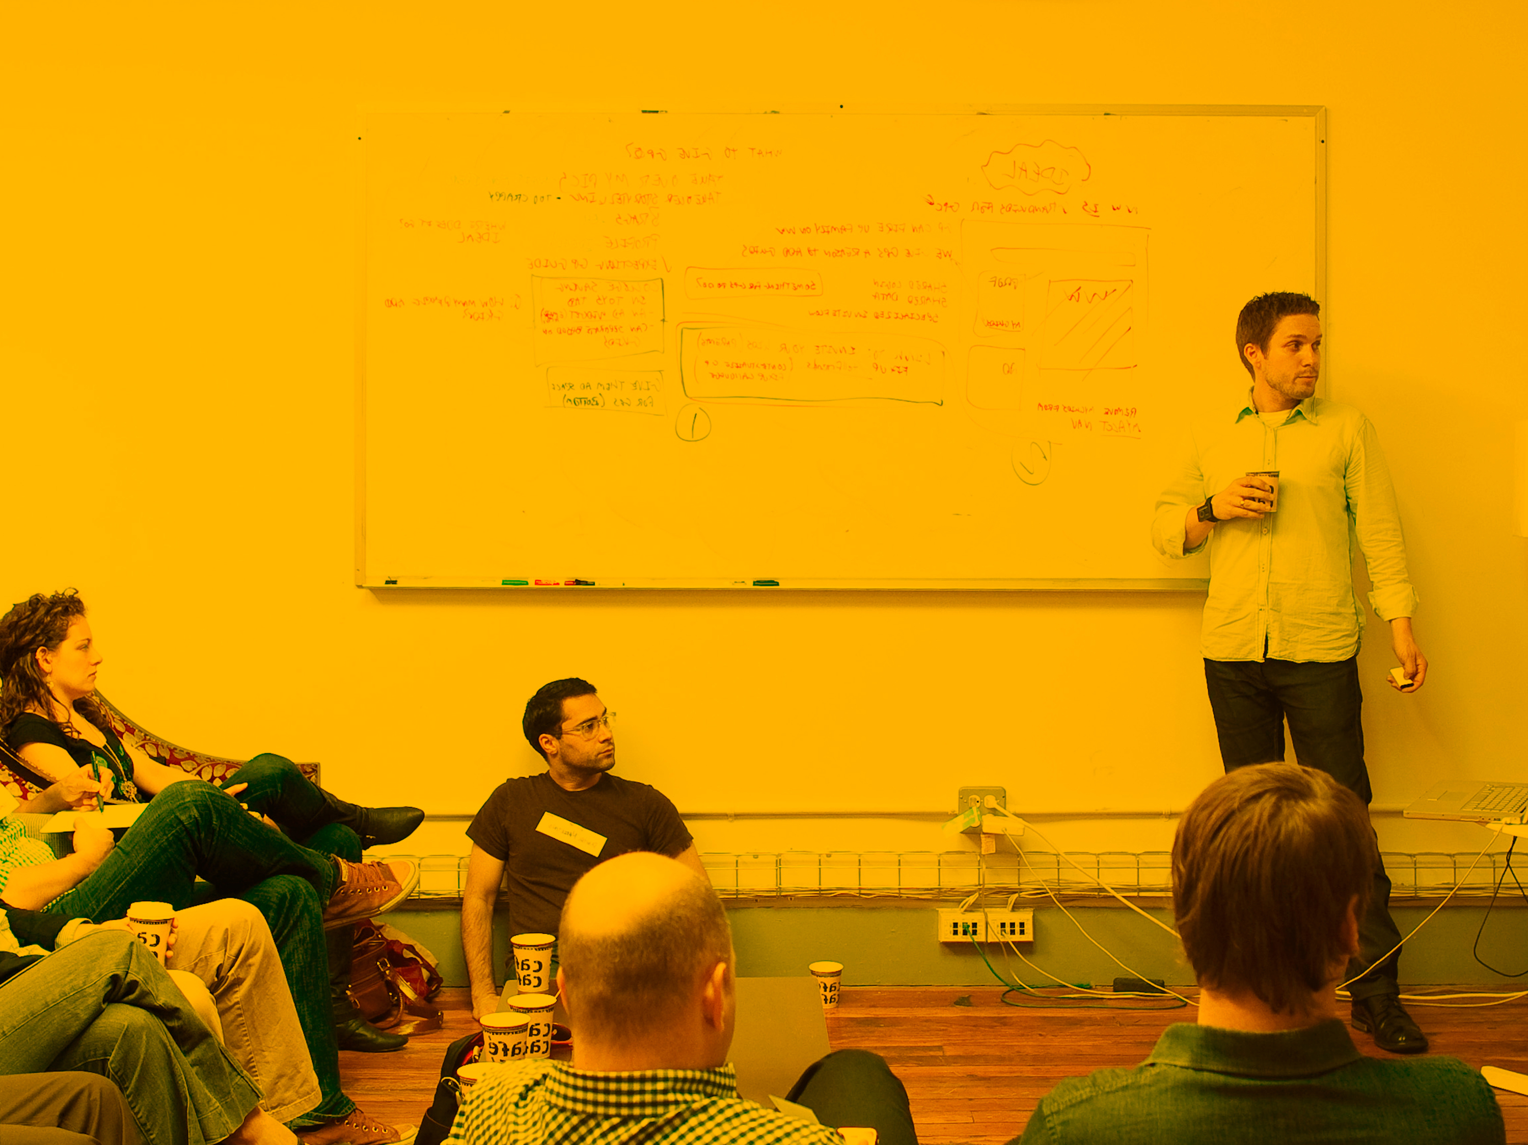
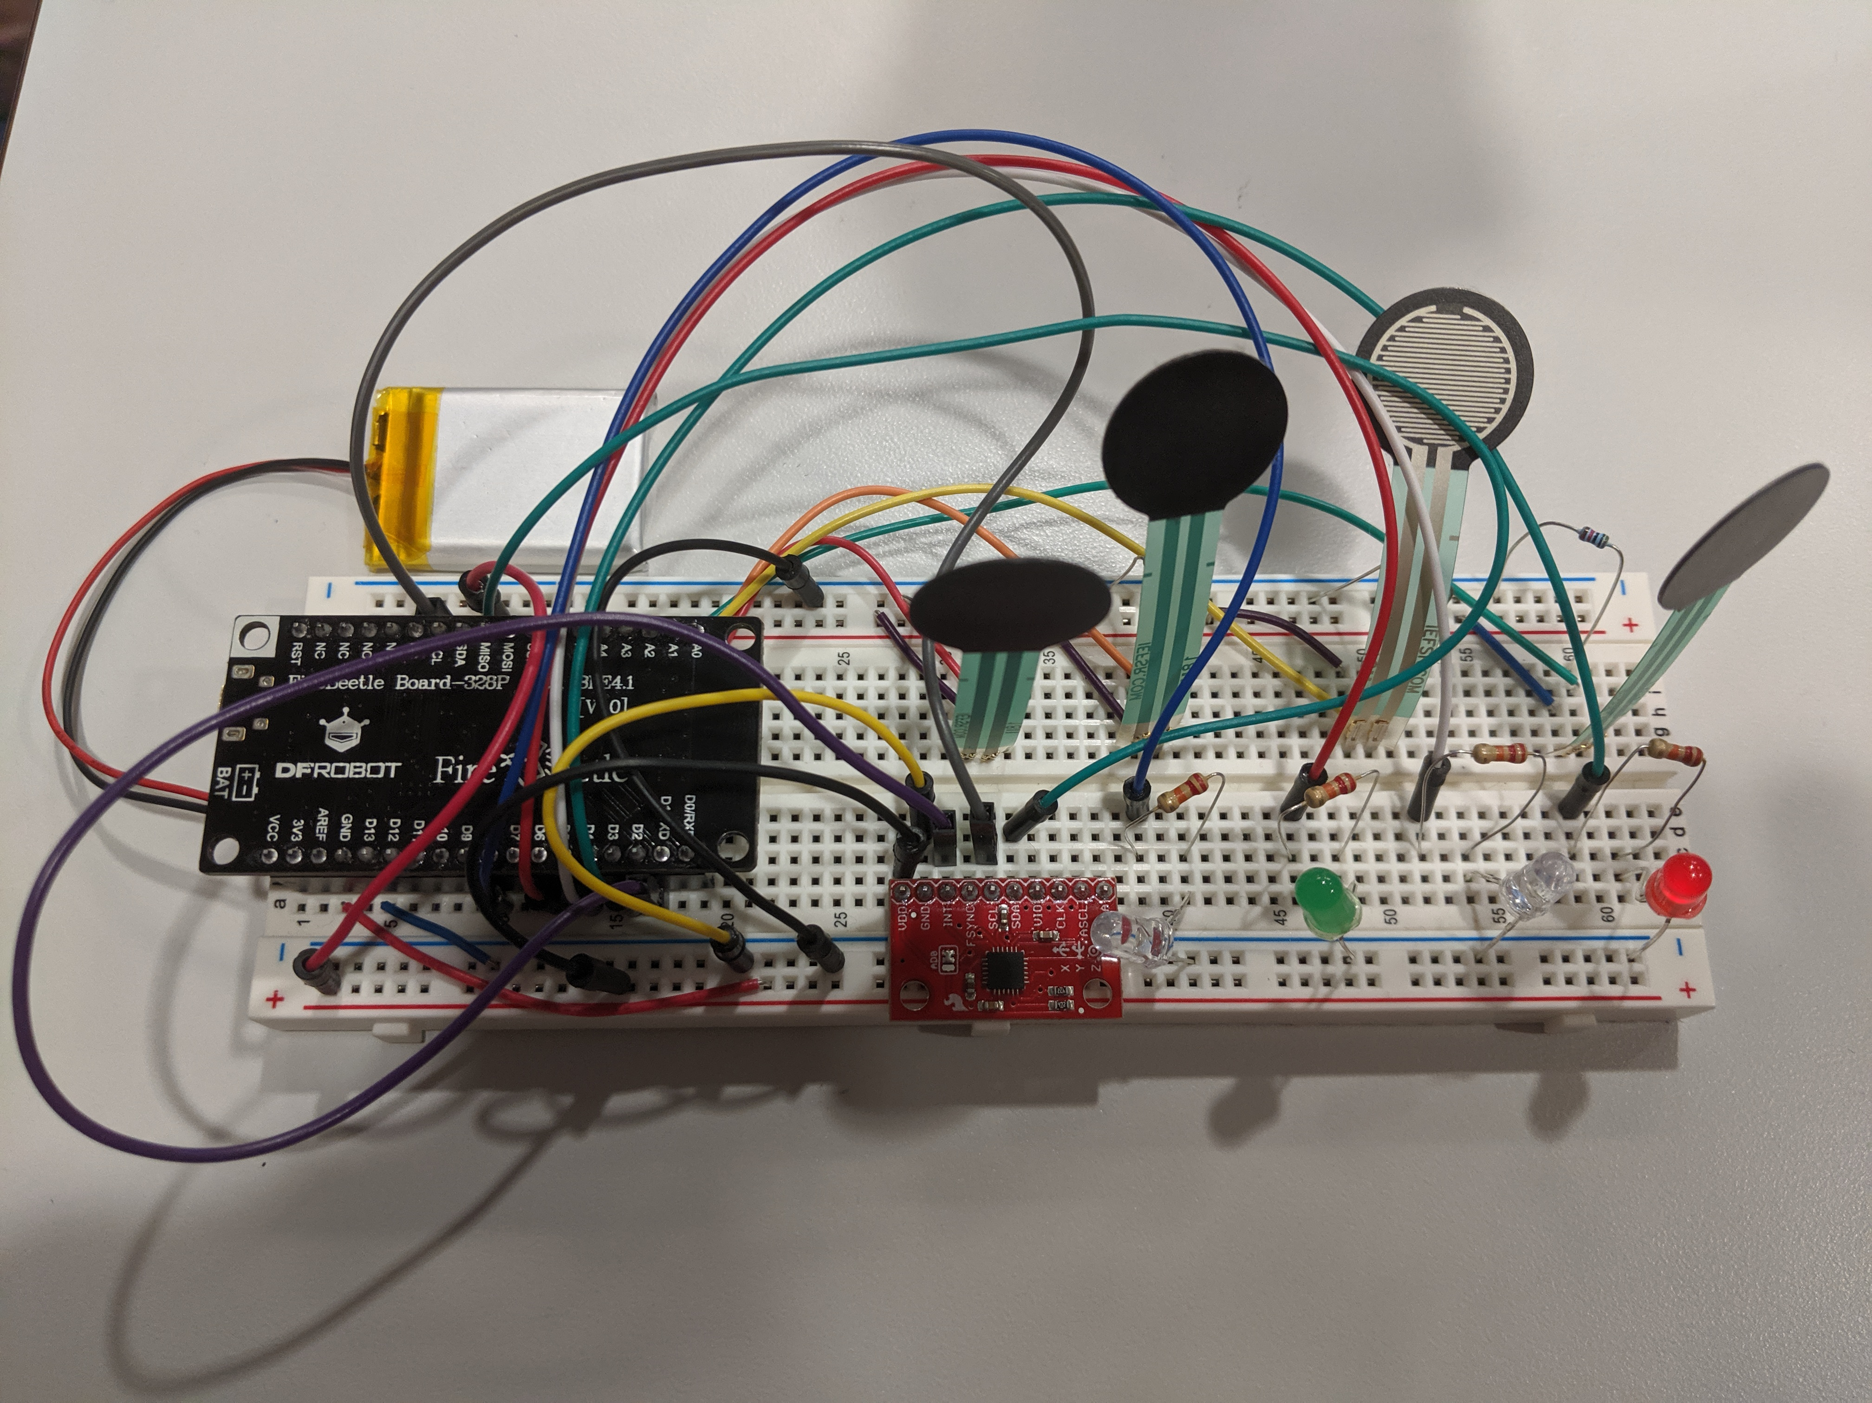
Prototype and Planning

Slide 3
TITLE TEXT GOES HERE
Long or short subtitle Ovit eruptam, omni iur, to dem quamet et officil idi quo beaquib ustionsed ea comnis is prerature volorum ium qui reicaep rectatur apis cusdaeptatia net quist.
Long or short subtitle Ovit eruptam, omni iur, to dem quamet et officil idi quo beaquib ustionsed ea comnis is prerature volorum ium qui reicaep rectatur apis cusdaeptatia net quist.

Slide 5

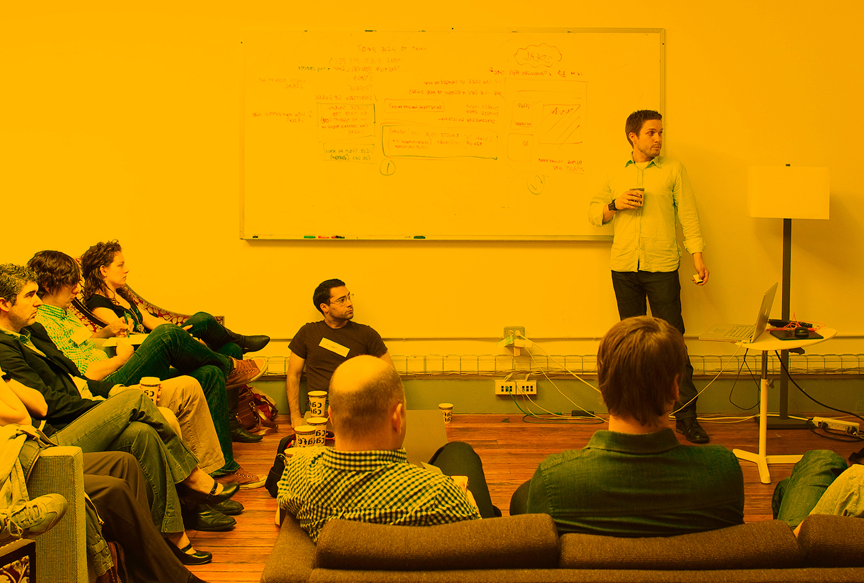
Long or short subtitle Ovit eruptam, omni iur, to dem quamet et officil .
Long or short subtitle Ovit eruptam, omni iur, to dem.

Slide 6
QUESTIONS
College of Name | Department of Name

